Slide 1
What drives geochemical variability in soils? Applicability to the fossil record.

Slide 2
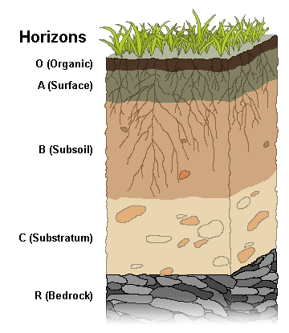
Typical soil horizons
Notes:
Explain soil horizons briefly

Slide 3
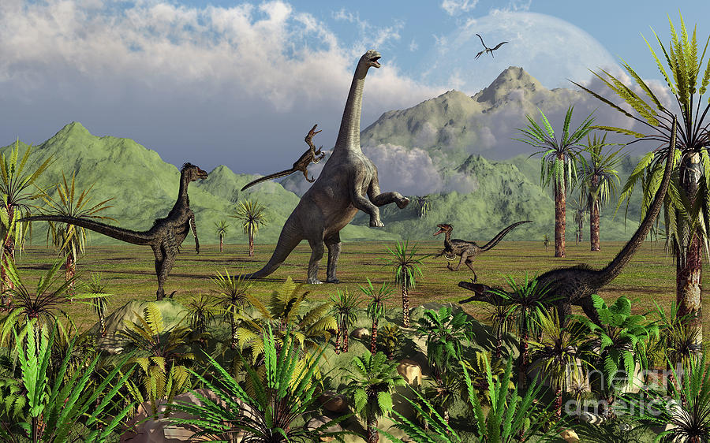
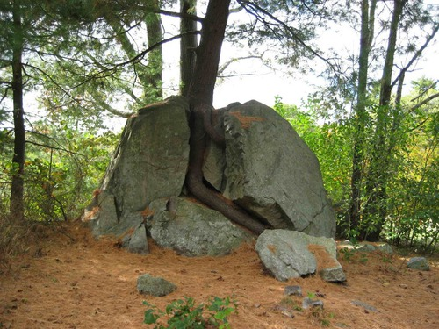
Why should you care?
Notes:
Crucial in reconstructing paleoenvironments. Mosaic of environments and niches.
Crucial to understanding weathering on land- site of chemical weathering. Silicate weathering (one of the) is the primary controls on atmospheric CO2 on geologic timescales.

Slide 4
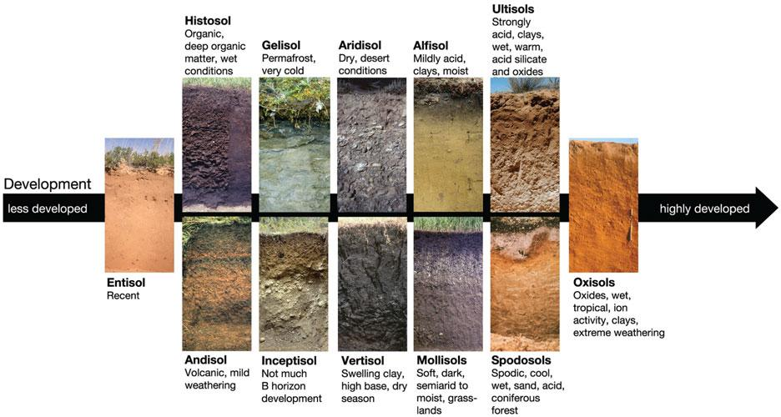
Order of soils and evolutionary history
Soil = F( Climate, topography, organisms, parent material, time of formation)
Jenny, 1941; Retallack, 2001;
Notes:
Soil are a function of …. Thus, based on these different physical and biotic controls there are several different types of soil. Entisols lack well defined soil horizons. Histosols develop in organic rich, wet conditions. Gelisol develop in permafrost cold conditions, while oxisols develop in wet tropical conditions. Like evolutionary organisms, different soils evolved at different points of time in geologic history. Mollisols evolved during the cenozoic during the paleogene-neogene spread grasslands, while alfisols evolved in the Devonian during the spread of the world's first forests.
Ultisols and oxisols are highly weathered soils.
Explore: Describing and classifying soil. Soil Classification, Soil Survey, and Interpretations of Soil. (2021, April 13). Retrieved October 29, 2021, from https://serc.carleton.edu/kskl_educator/soil_classification/chap_5_explore.html.

Slide 5
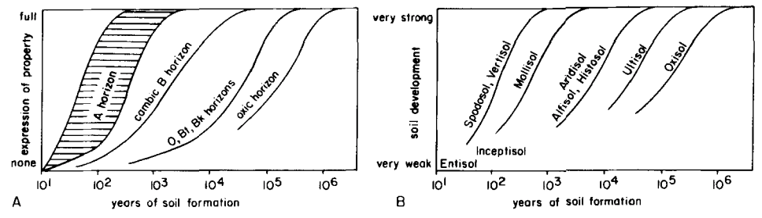
Soils formation operates on varied time scales!
Birkeland, 1999
Notes:
Different soils and soil horizons take different durations to form.
The graph on the left shows the expression of a soil horizon plotted against time on the x axis.
The graph on the right shows soil development plotted against time of soil formation.
The point is soils represent vastly varied time scales.

Slide 6
Variability in soils = F(Climate, topography, organisms, parent material, time of formation)
geochemistry
Principal Component Analysis!

Slide 7
Method
?
Geochemical indices
Climate/Weathering
Notes:
What is driving variance in soil geochemistry.

Slide 8
Method
Compiled soil geochemistry, climate, topography, elevation data for ~1000 soils.
Excluded soils disturbed by human activity.
Excluded soils that had incomplete geochemical or soil type information.

Slide 9
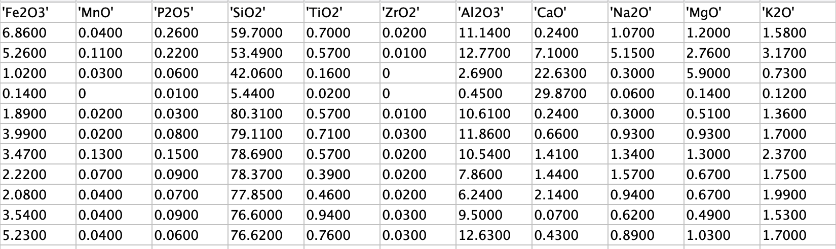
Method

Slide 10
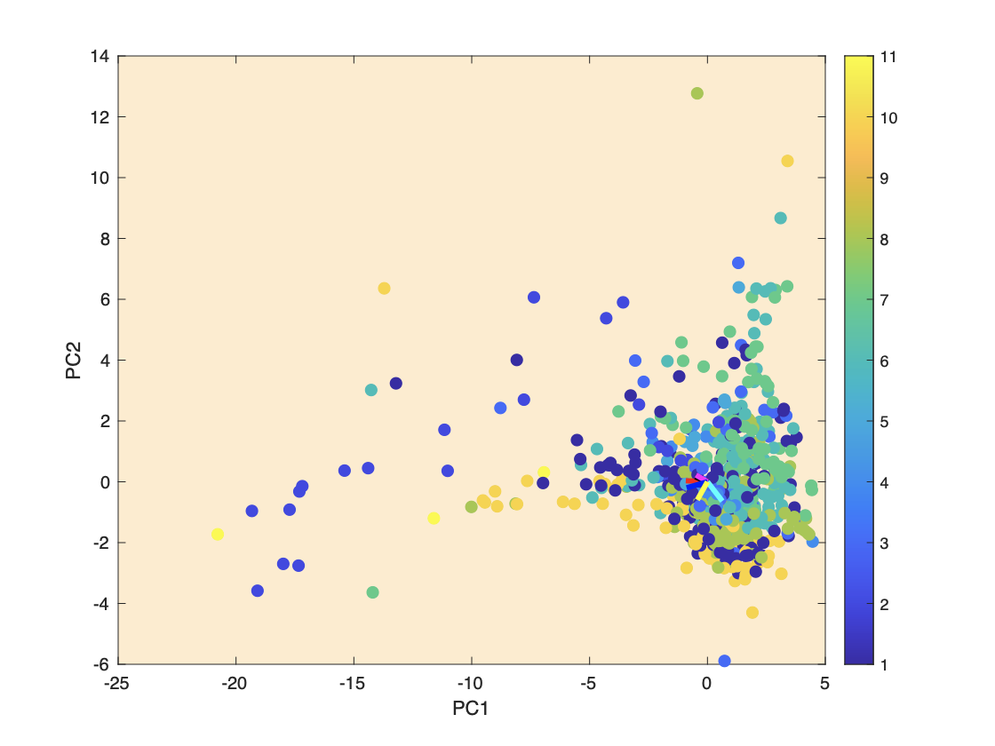
PC axis
Oxisols
Ultisol
Histosols
Alfisol
Aridisol
Percentage of Variance PC1: 30.4124%
PC2: 17.7805%
PC3: 14.1218%
PC4: 7.6559%
Mollisol
Vertisol
Spodosols
Entisol
Andisols
Inceptisols
Fig. Soil age control on variability?

Slide 11
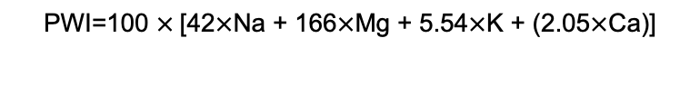
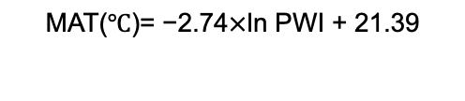
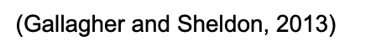
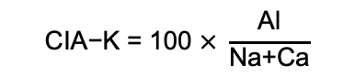
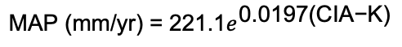
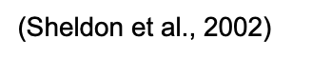
Climate proxies - PWI and CIA-K
Notes:
Climate proxies that have previously been defined in the literature

Slide 12
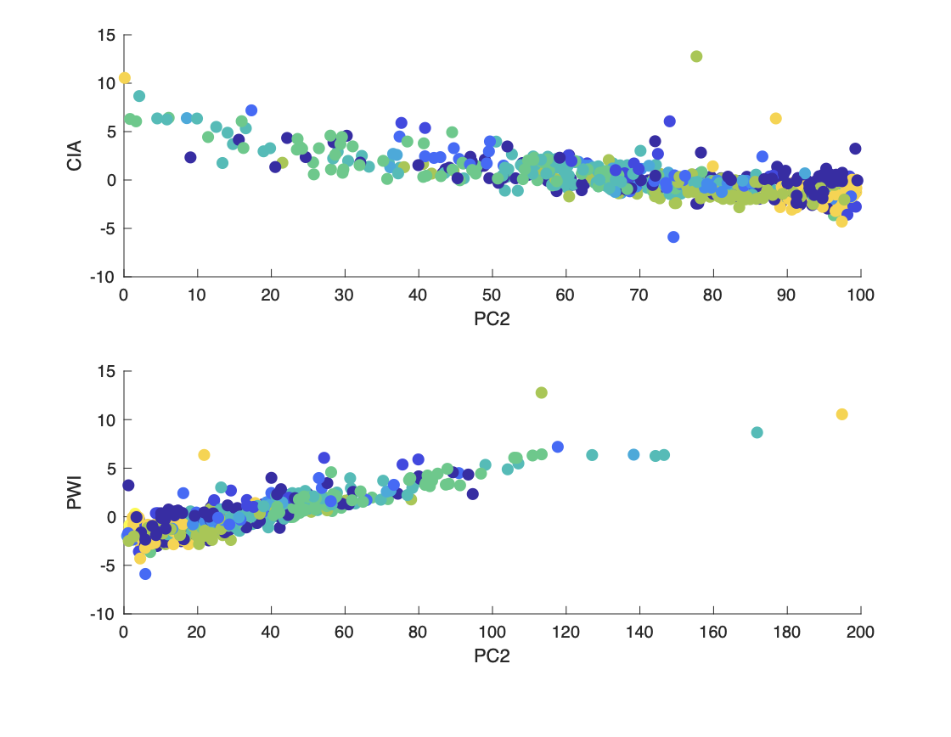
Climate proxies - PWI and CIA-K
PWI and CIA-K vary linearly with PC2
Notes:
Very surprising that these previously defined indices correlate with PC2! This means I’m doing something right. But all variance in data not encompassed by PC2

Slide 13
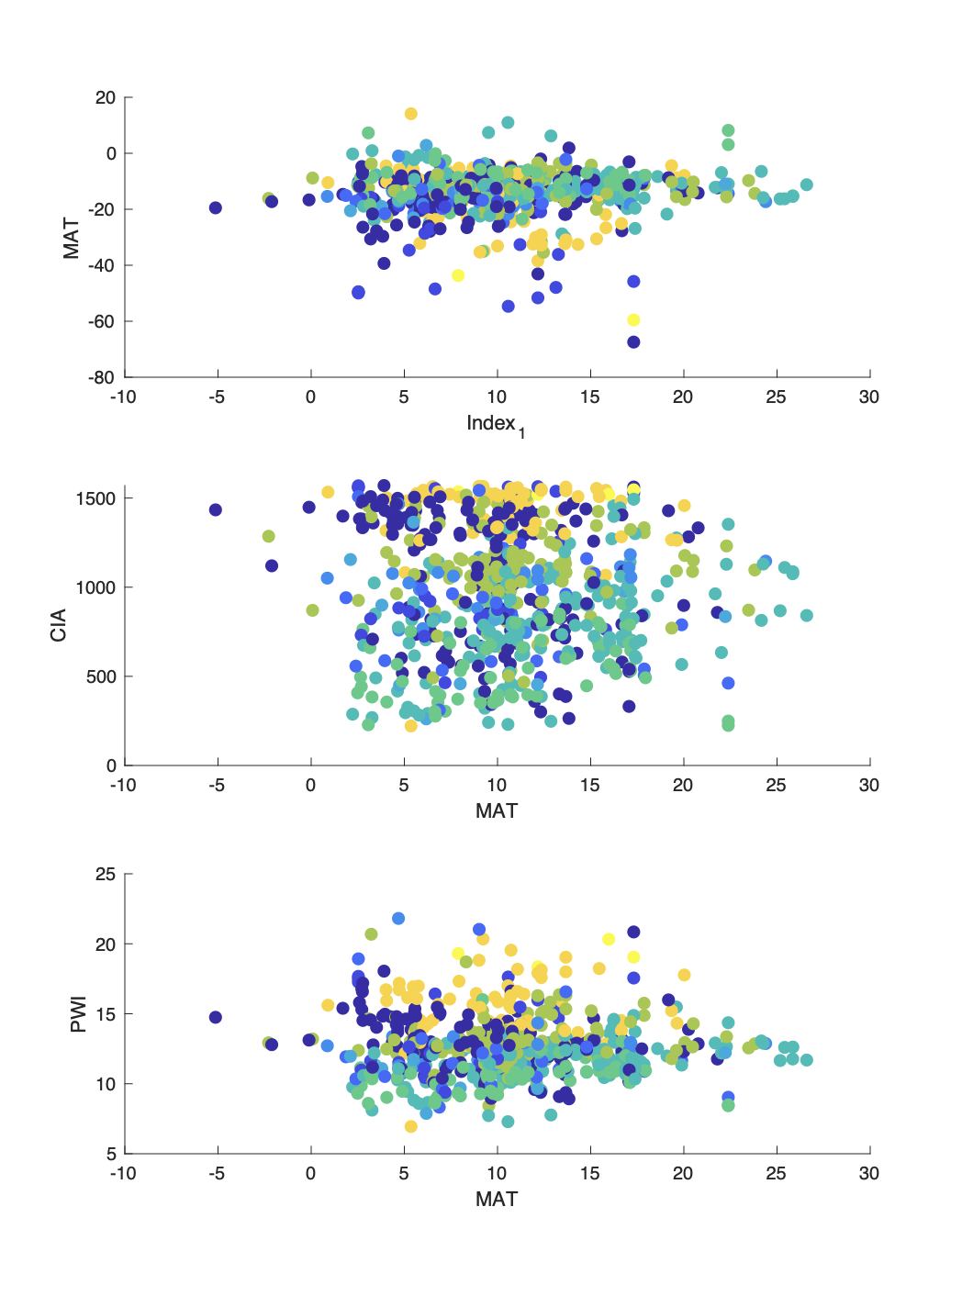
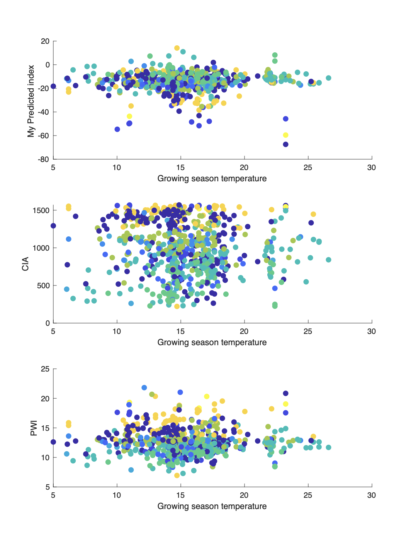
Temperature v/s PWI and CIA-K
Notes:
Explain the figures. I don’t see a relationship between these proxies and temperature data!

Slide 14
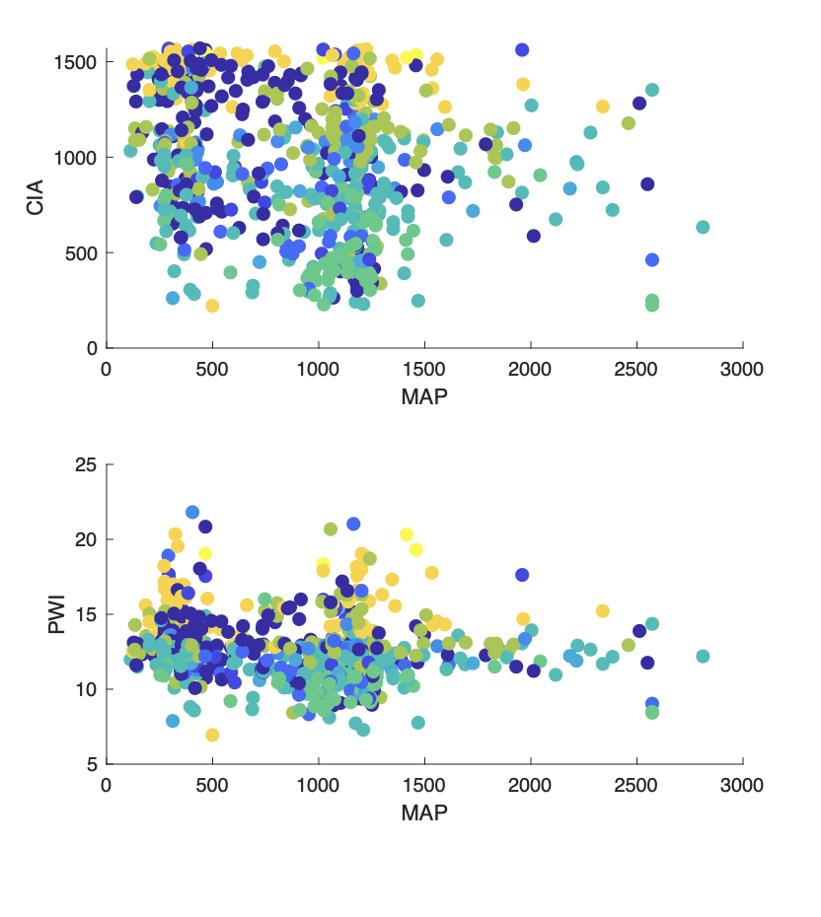
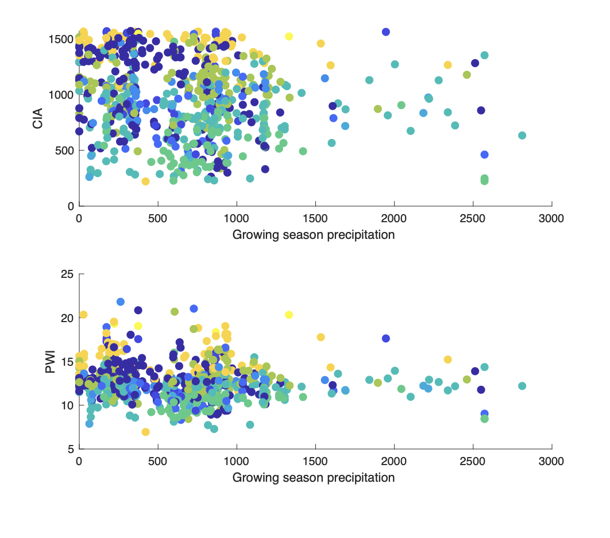
Precipitation v/s PWI and CIA-K
Notes:
Explain the figures. I don’t see a relationship between these proxies and precipitation data

Slide 15
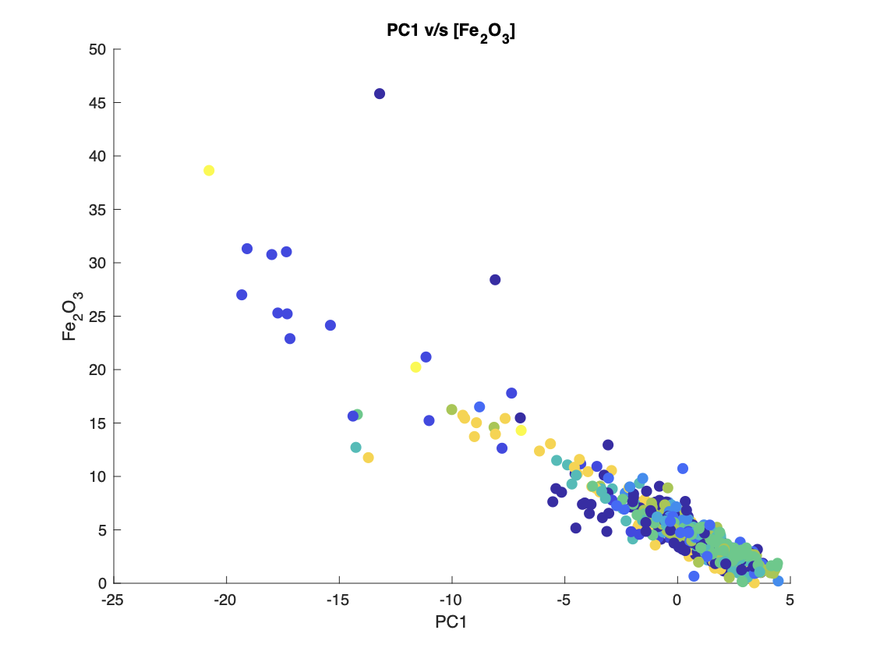
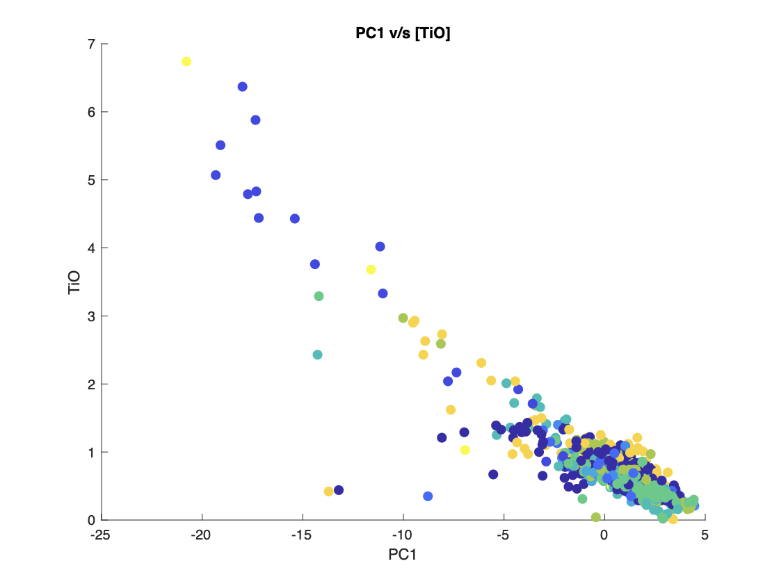
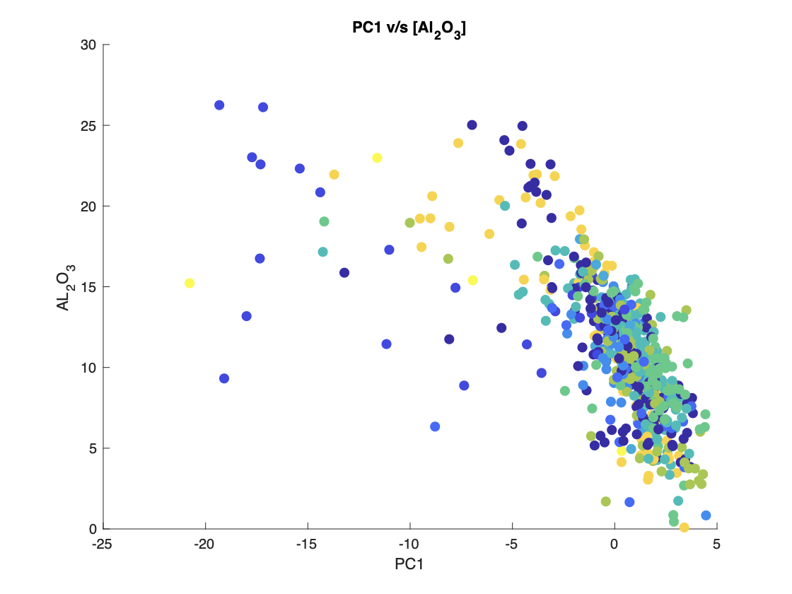
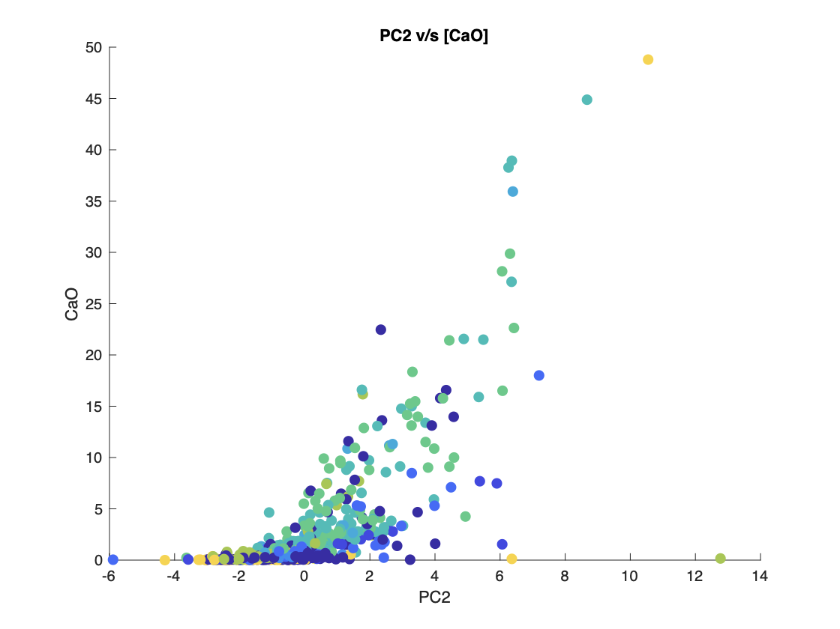
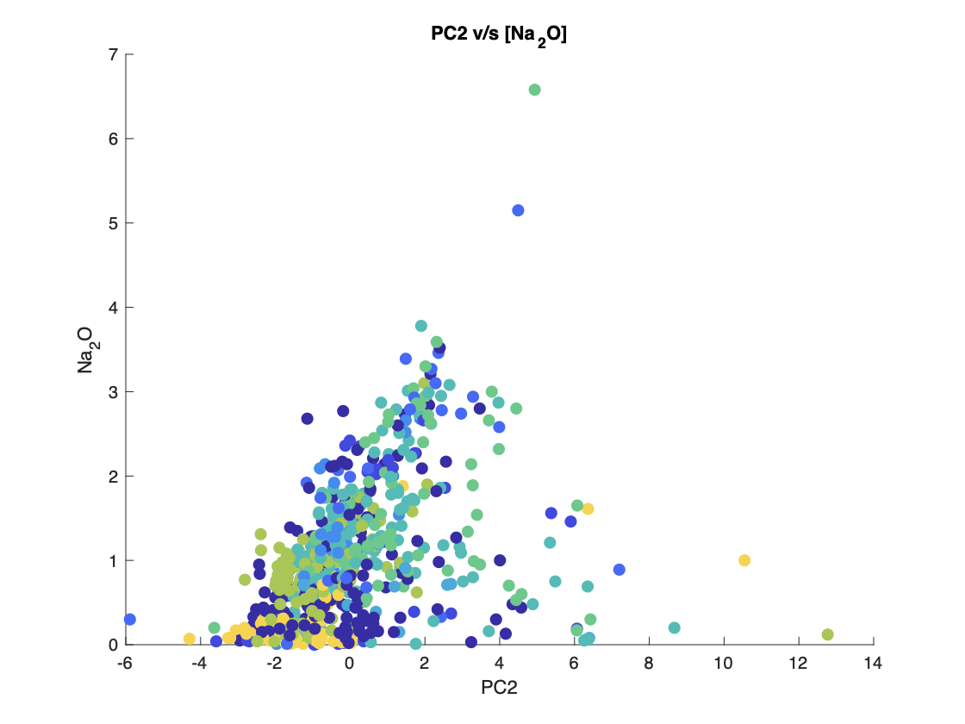
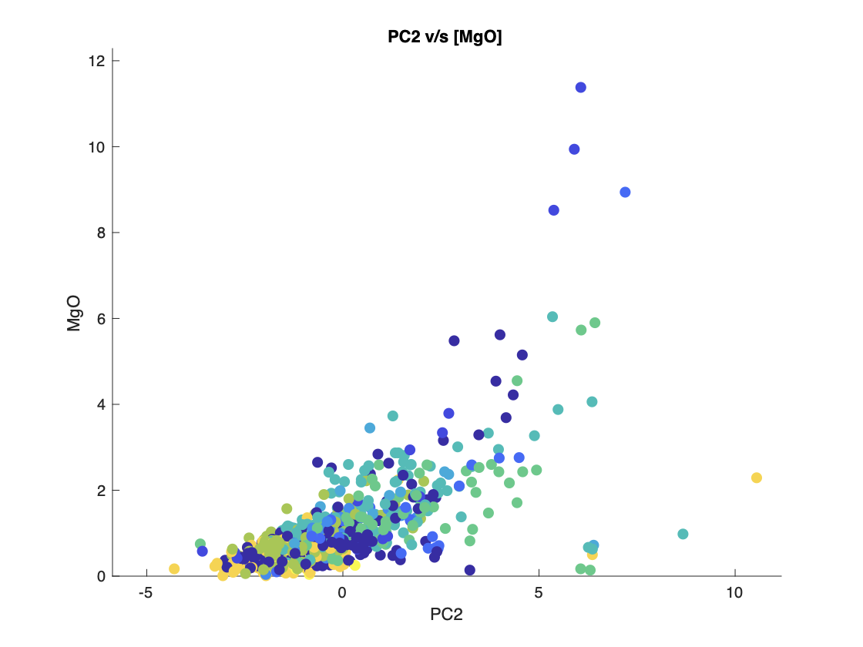
Which metal oxides contribute the most towards variance?
Notes:
For out PC plot let us investigate which metal oxides contribute the most towards variance in geochemistry.
For PC 1 ….
For PC 2….

Slide 16
Smart Chemical Index (SCI)
Choose the metal oxides that vary closely with PC1 and PC2.
Element_Matrix1 = [Ti Fe Al]; %Elements varying most with PC1
Element_Matrix2 = [Ca Na Mg];%Elements varying most with PC2
Weight_Matrix1 = PC1 \ Element_Matrix1;
Weight_Matrix2 = PC2 \ Element_Matrix2;
SCI = -0.18*Ti - 1.18*Fe - 0.83*Al + 1.94*Ca + 0.18*Na + 0.47*Mg
Notes:
Ti Fe Al vary linearly with with PC1 and Ca Na Mg vary linearly with PC2.
SCI = Weight_Matrix1(1) .* Ti + Weight_Matrix1(2) .* Fe + Weight_Matrix1(3) .* Al + Weight_Matrix2(1) .* Ca + Weight_Matrix2(2) .* Na + Weight_Matrix2(3) .* Mg;

Slide 17
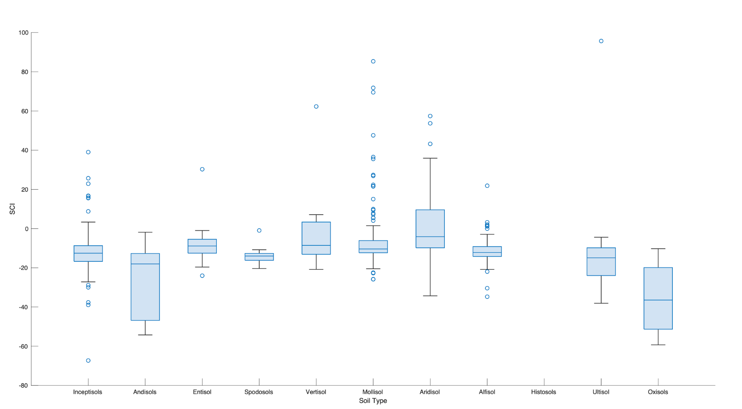
Smart Chemical Index (SCI) v/s soil type
Chemical Weathering?
Notes:
Possible indicator of weathering? As Ultisols and oxisols are highly weathered soils.
Use in ocean sedimentary cores as an indicator of terrestrial weathering?

Slide 18
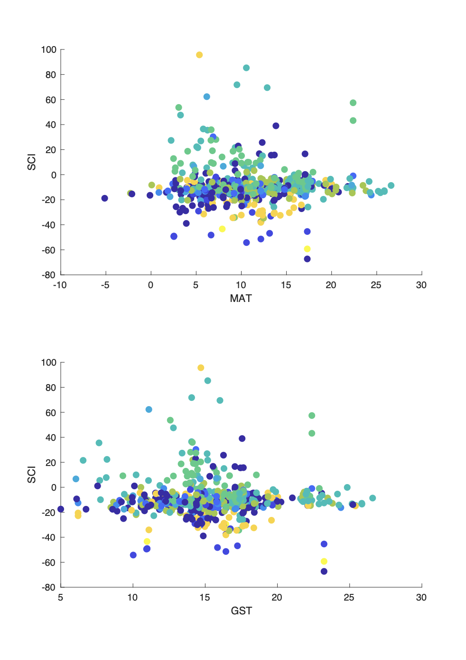
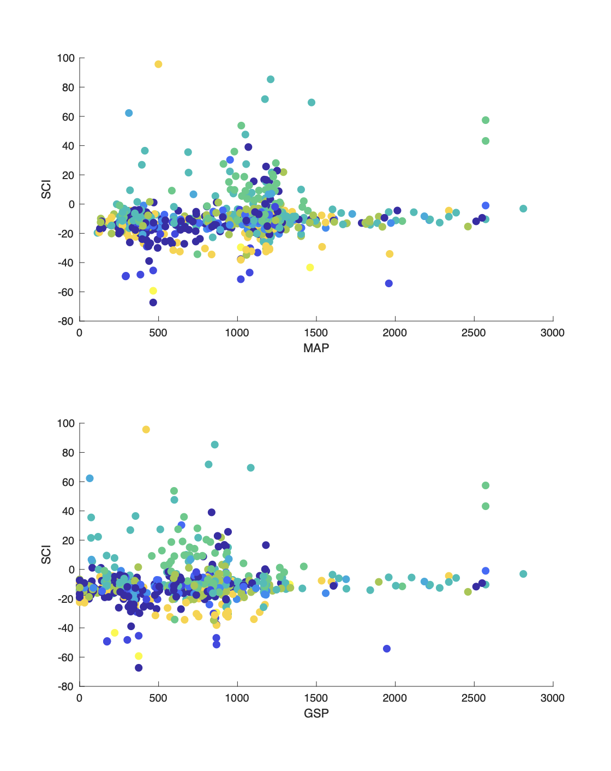
SCI v/s
Climate
Notes:
GST -> Growing season temperature.
GSP -> Growing season precipitation.
MAT-> Mean Annual Temperature
MAP-> Mean Annual Precipitation

Slide 19
Next steps?
Go through data in more detail. Scatter could possibly be a result of human derived environmental change.
Toggle soil types.
Derive other indices by using ratios of metal oxides rather than their sum. Non-linearity in scaling.
Soils take up variability due to Last Glacial. Since soils take up 1000’s to millions of years to form, orbital oscillations affecting climate likely affect the ‘genetics’ of soils.
Get datasets from other parts of the world -> more ‘pristine soils’. More oxisols, more histosols.

Slide 20
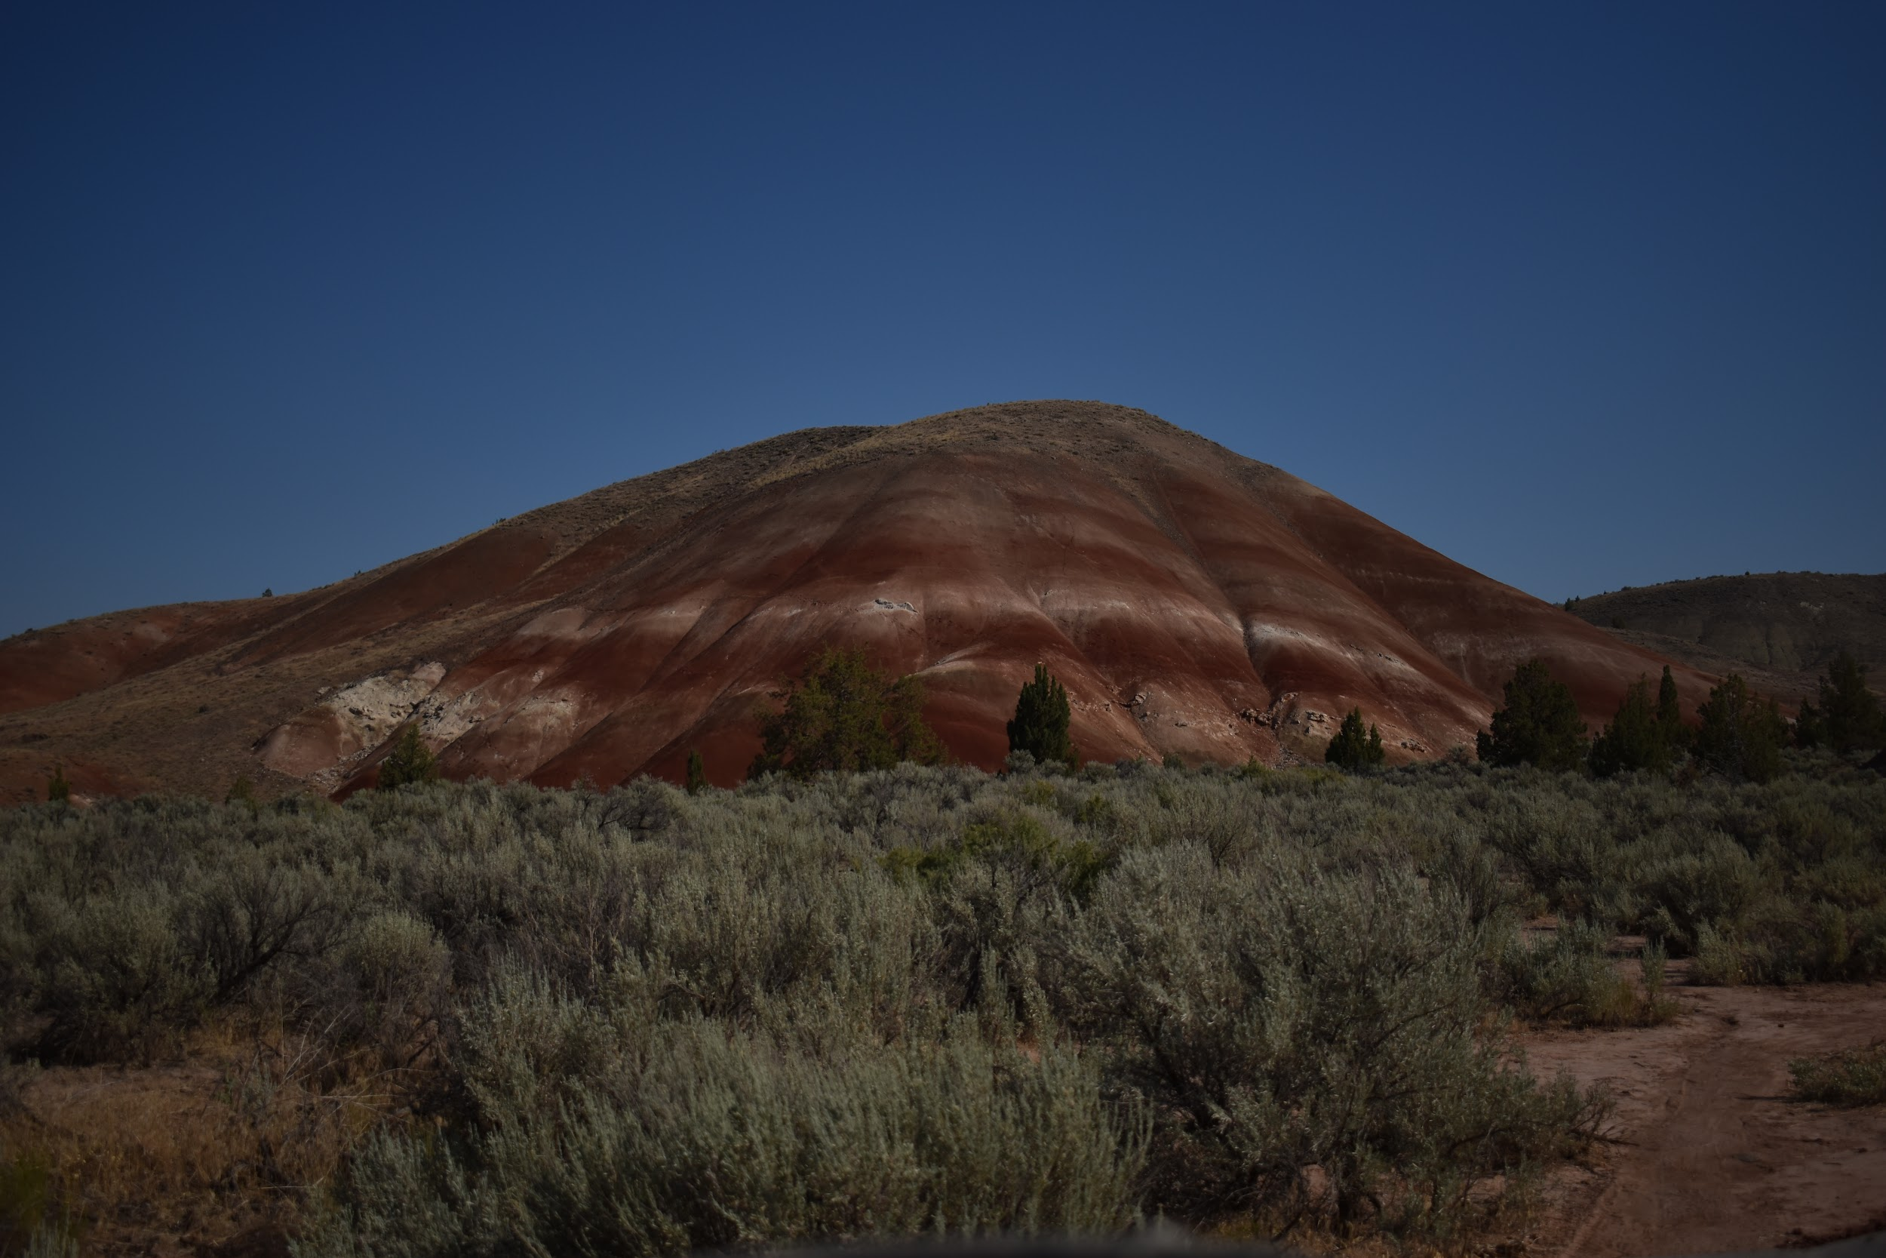
Thank you!
Acknowledgement:
Madison Raftor (CSUN), Dr. Jen Cotton (CSUN), Dr. Ethan Hyland (NCSU), Dr. Naomi Levine (USC)
Code & Data available @ https://github.com/ghosh17/SoilGeochemistryPaleoclimate
Fossil soils from the John Day Fossil Beds in Oregon. (June 2020)

Slide 21
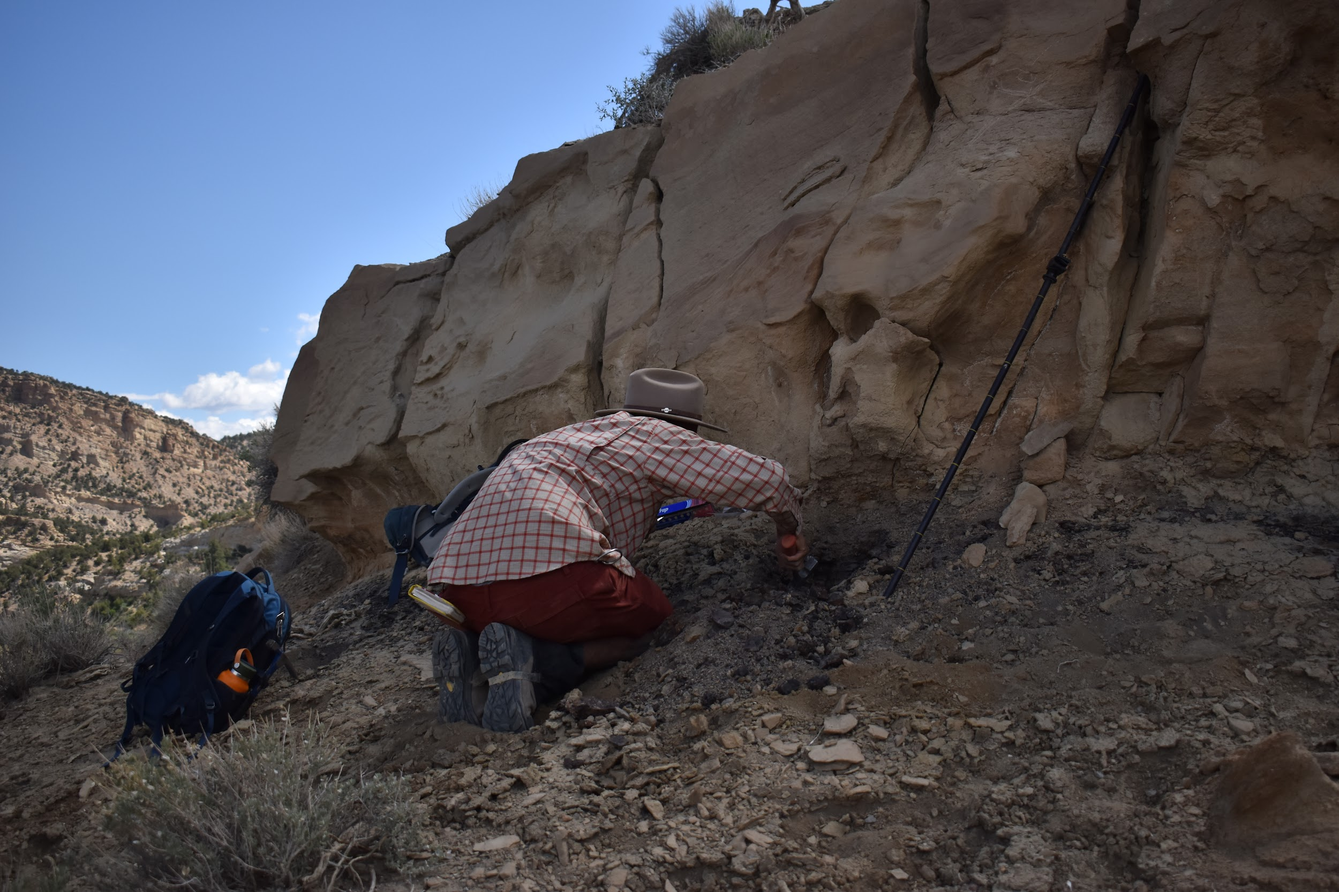
Extra slides- Alfisol in Utah
Lots of dinosaur and such.
Straight Cliffs Formation, Cretaceous, Utah
June 2020

Slide 22
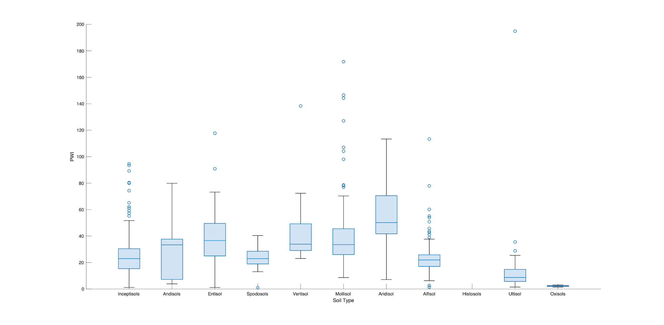
Soil type v/s PWI

Slide 23
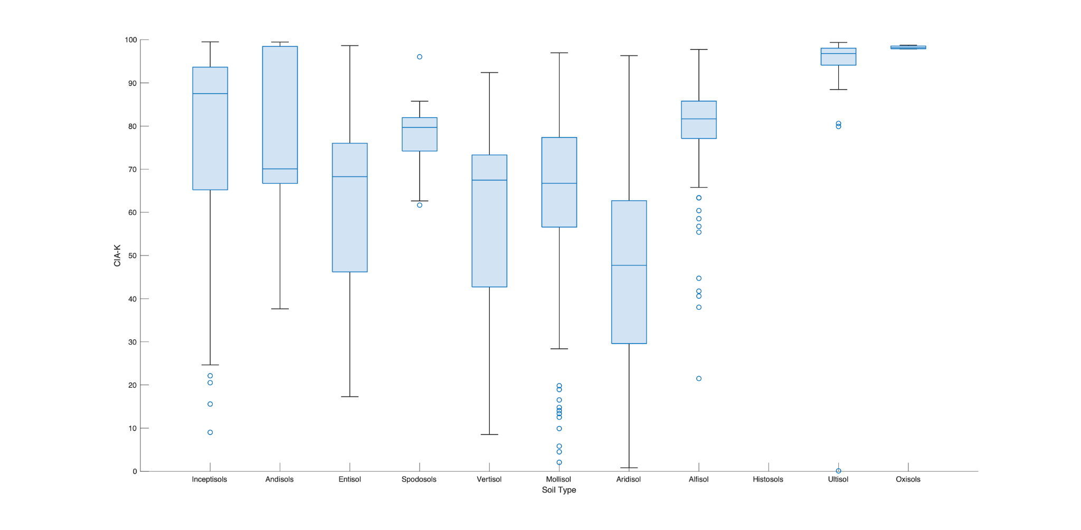
Soil type v/s CIA-K

Slide 24
What is ‘soil’? = Hard to define
In engineering - soil is any material that can be excavated without recourse to quarrying or blasting.
for farming purposes, soil is fertile, loose, tillable ground
“soil to be material forming the surface of a planet or similar body and altered in place from its parent material by physical, chemical or biological processes.”
Retallack, Soils of the Past
“medium in which vascular plants take root” (Buol et al. 1997)
Definition too narrow
Wider definition

Slide 25
References
Berner, R.A, (1992) Weathering, plants, and the long-term carbon cycle, Geochimica et Cosmochimica Acta, Volume 56, Issue 8,
Gallagher T. M., Sheldon, N. D. (2013). A new paleothermometer for forest paleosols and its implications for Cenozoic climate. Geology, 41 (6), 647–650. doi:https://doi.org/10.1130/G34074.1
Hartmann, J., (2009) Bicarbonate-fluxes and CO2-consumption by chemical weathering on the Japanese Archipelago — Application of a multi-lithological model framework, Chemical Geology, Volume 265, Issues 3–4
Jenny, H. (1941) Factors of Soil Formation (McGraw–Hill, New York).
Nordt, L.C., Driese, S.D.; New weathering index improves paleorainfall estimates from Vertisols. Geology 2010;; 38 (5): 407–410. doi: https://doi.org/10.1130/G30689.1
Rasmussen, C., Troch, P.A., Chorover, J. et al. An open system framework for integrating critical zone structure and function. Biogeochemistry 102, 15–29 (2011). https://doi.org/10.1007/s10533-010-9476-8
Retallack, G. (2001). Soils of the past - an introduction to paleopedology. Wiley.
Sheldon, N.D., Retallack, G.J., Tanaka, S. (2002). Geochemical climofunctions from North American soils and applications to paleosols across the Eocene-Oligocene boundary in Oregon. Journal of Geology 110, 687-696.
Stinchcomb, G. E., et al. “A Data-Driven Spline Model Designed to Predict Paleoclimate Using Paleosol Geochemistry.” American Journal of Science, vol. 316, no. 8, 2016, pp. 746–777., https://doi.org/10.2475/08.2016.02.

